Slide 1
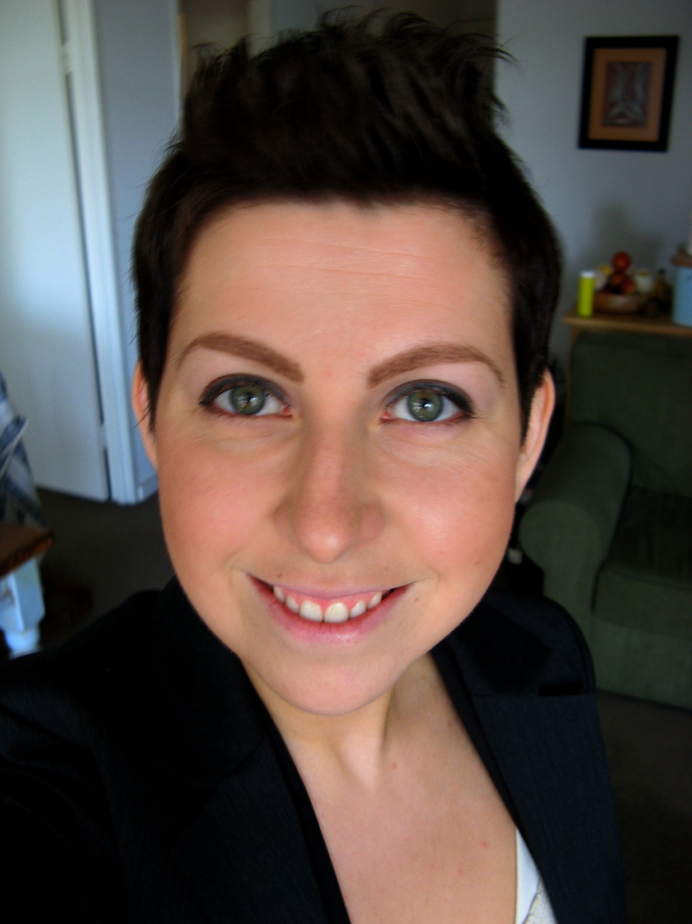
Paula (30)
Substitute teacher in Media Studies at the secondary school level. As a substitute teacher, she teaches multiple subjects when work becomes available.
Paula is single. She has no children. She has no pets, as she has allergies to pet dander.
Social media: Facebook, Twitter, LinkedIn, Google+
Paula uses educational tools, apps, and games - including on mobile platforms.
"I think in general the most important benefit of Internet is sharing. Why wouldn't I share [my material] if something I have created could be of help or use to someone else?"
Source: https://www.flickr.com/photos/jennifrog/3764498368/

Slide 2
Motivation
Paula is highly motivated to prove her worth and build stills for a more secure job position. She is building a portfolio of self-made learning resources and educational games.
Challenges
Even though Paula is quite a flexible person and goes where opportunities take her, she often finds long-term planning challenging given that she has short-term and part-time contracts. She also has to struggle with personal finances.
Appreciates
Paula appreciates sharing, inspired by the Free Culture movement. She shares her knowledge openly, often helping other teachers with technology problems, finding educational materials, etc.
Paula also appreciates organic food and city living.
Dreams
Paula dreams of having a permanent teaching job.
Fears
Paula fears not getting ahead and not making a difference. She is also worried about environmental issues, pollution and global warming.
Crowducate considerations
Paula is primarily focused on the quality of content and ease of collaboration/sharing features.
Quality of Content
Feedback
Course reviews
Ratings
Search and Discovery
Description
Course Metadata
Curricular Standards Alignment
Collaboration and Sharing
Editing and Collaboration
Culture of sharing
Copyright
Creative Commons
Import/Export/Integration
Export to common formats
Import common formats
Integrate resources from common sources

Slide 3
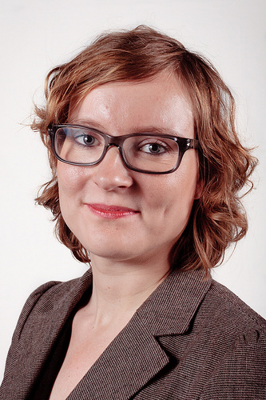
Maria (41)
French teacher, Grade 5, permanent position
Maria is married. She has two children and one dog.
Social media: uses Facebook
Maria is not computer savvy. Her school has both mini-laptops and iPads, but she feels reluctant to use them: feels that she doesn’t have enough time to learn to use them.
"You never know about your evenings because of kids. --- I'm a bit terrified of the process for searching for [educational] material. Since I don't have much time for searching the material, it is often faster to create it myself."
Source: https://www.flickr.com/photos/pvdanl/6881034435/

Slide 4
Challenges
Maria has some challenges with parents of her pupils, in that they don't always appreciate her perspective. She would also like to spend more time focusing on her pupils.
Maria is struggling in seeking work/life balance.
Appreciates
Maria appreciates spending time in her summer cottage.
Dreams
Maria dreams about a family trip to Euro Disney.
Fears
Maria has concerns about privacy and identity online. She is afraid of identity theft.
Crowducate considerations
In general, Maria is focused on the quality of the platform.
Platform Quality
Simplicity and Ease of Use
Stability and Reliability
Interactiveness
Quizzes
Manipulating geometric forms
Aesthetic quality
Clean design
Clear signifiers and constraints
Help and support
Help community
Documentation
Accessibility
Readability
Discoverability
Browser support
Security

